Slide 1
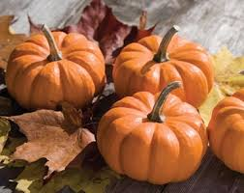
The Johnson Times
Week of October 29th
Game Plan: Specials
Monday- Spanish
Tuesday- P.E.
Wednesday- art
Thursday- chess
Friday- music
Notes from the teacher
Iready is up and running, please have your child complete 45 minutes of both math and reading each week. Their login information is written in their agenda. I will be counting the 45 minutes for each subject as a class work grade.
. 10-31- character dress up day- students can dress up as their favorite story book character. They need to bring a book that goes along with it.
jnsjk
Math | Language Arts | Social Studies | Science
-Understand the relationship between multiplication and division. Demonstrate that fact families are related multiplication and division equations. Assessment- U3 usa | Reading Skills: - -what are poems made of Grammar: adverbs Assessments: 11/2- u2 fsq2 |  | How the world works Begin science unit on space Central idea- Earth is part of an interconnected system that affects our daily lives.

