Slide 1
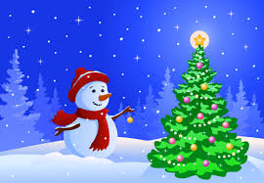
The Johnson Times
Week of December 3rd
Game Plan: Specials
Monday- Spanish
Tuesday- P.E.
Wednesday- art
Thursday- chess
Friday- music
Notes from the teacher
please have your child complete 45 minutes of both math and reading each week. Their login information is written in their agenda. I will be counting the 45 minutes for each subject as a class work grade.
jnsjk
Math | Language Arts | Social Studies | Science
Understand what a fraction is. Introduction to fractions. | Reading Skills: - Main idea and key details Grammar: Irregular plural nouns Assessments: 11-/9- u5 fsq and editing task | Who we are- review 5 regions and all of the states in them | How the world works Begin science unit on space Central idea- Earth is part of an interconnected system that affects our daily lives.

